Slide 1
Civil Rights Subsystem (CRS)
Contractors (iCX)
TRAINING
April 2020

Slide 2
Overview
1.0 Contractor Rollout Plan
2.0 Conformances SF 1444
2.1 Conformances Document
3.0 Certified Payroll
3.1 Add Payroll
3.2 Payroll Entry
3.3 Fringe Benefit
3.4 Sign Certified Payroll
3.5 Attach Documents
3.6 Submit payroll to Prime
4.0 Subcontractor – Review submitted payroll
5.0 Subcontracting – Add subcontractor
6.0 1391 Annual EEO Report
7.0 Prompt Payment
7.1 Sub Contractor Payment Approval
April 2020

Slide 3
1.0 Contractor Rollout Plan
Once training is complete all contractors will utilize iCX for submission of certified payrolls and prompt payments reports for all new construction projects.
As part of the subcontractor approval process all subcontractors will be required to enroll into iCX and establish permissions for submission of certified payrolls and acknowledge payments made to them by the prime contractor.
Prime contractors will submit their certified payrolls through iCX for review by the Office of Federal Compliance (OFC).
Subcontractors are required to submit their certified payrolls into iCX for review by the prime contractor for their review before forwarding them to the OFC for approval.
Prime contractors will enter subcontractor payments into iCX for subcontractors to acknowledge prompt payment.
If applicable, subcontractors will enter their payments into iCX for acknowledgement by lower-tier contractors.
OFC will monitor all processes and procedures.

Slide 4
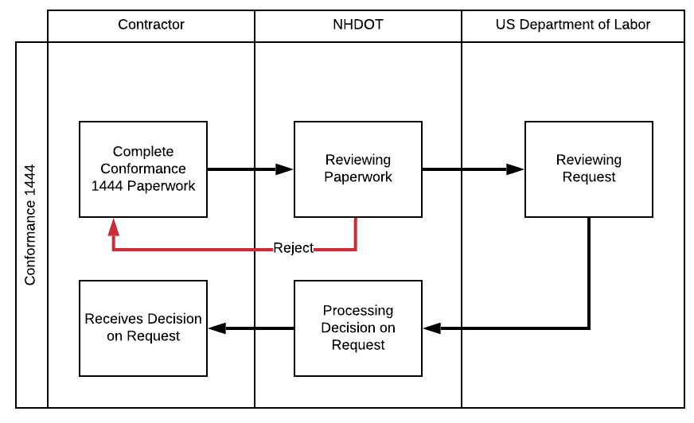
2.0 Conformances SF 1444
New Request
Menu >> NHDOT Document Library >> Payroll Documents & Tools >> SF 1444 AWCR
Email completed form to laborcompliance@dot.nh.gov
DOT Response pending USDOL approval
Notes:
Voice :: NHDOT

Slide 5
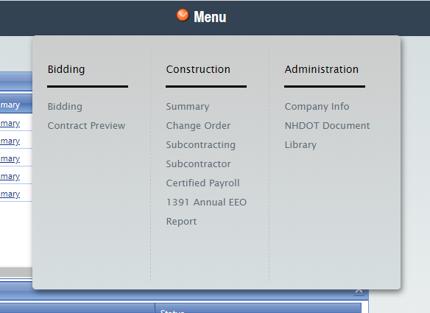
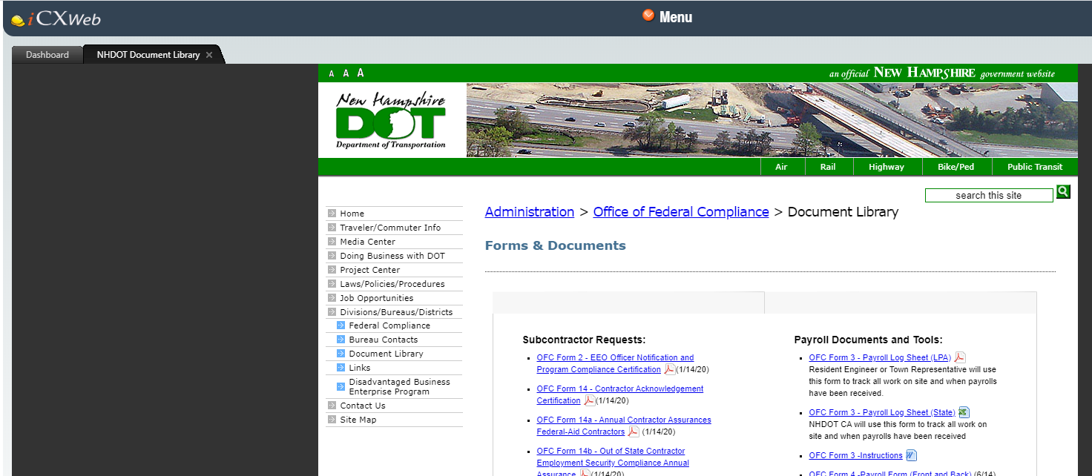
2.1 Conformances Document
Menu >> NHDOT Document Library >> Payroll Documents & Tools >> SF 1444 AWCR
Complete Form
Submit as soon as possible to allow time for processing: laborcompliance@dot.nh.gov
Notes:
Voice :: NHDOT

Slide 6
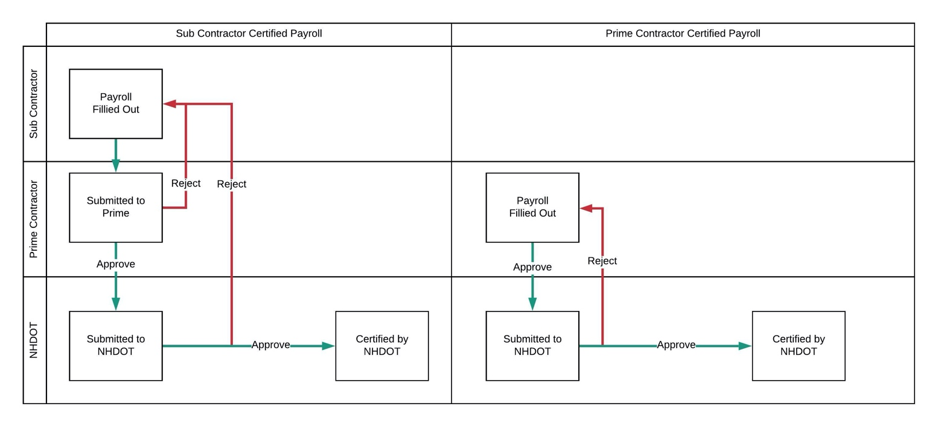
3.0 Certified Payroll
Payroll Approval Process
Sub vs Prime Certified Payroll

Slide 7
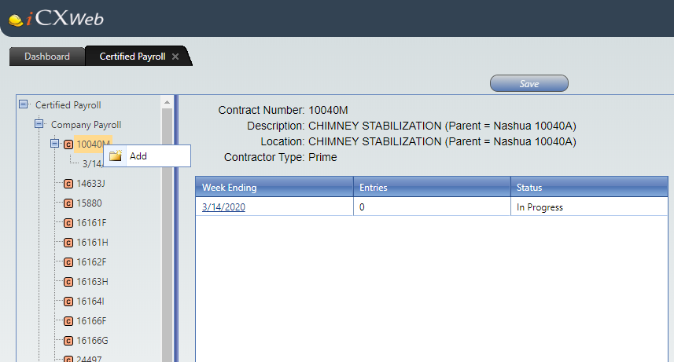
3.1 Add Payroll
Menu >> Certified Payroll
Prime vs Sub Contractor
Select Contract
Right Click >> Add
Right Click >> Copy

Slide 8
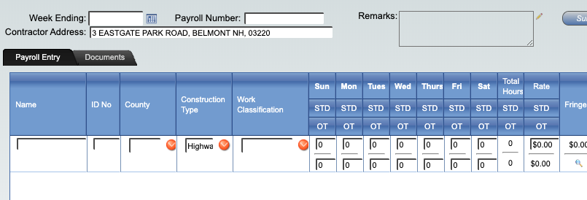
3.2 Payroll Entry
Header Information
Add Payroll Entry
Other - Description
Validation (Red/Yellow)
Add Fringe
Other Documents
Submit

Slide 9
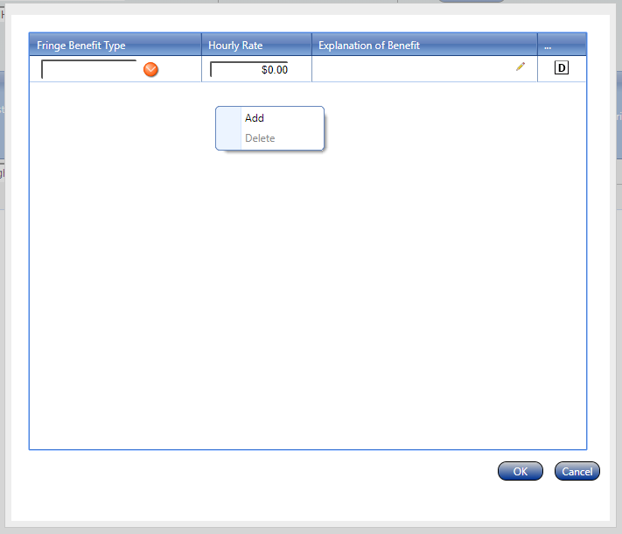
3.3 Fringe Benefit
Right click - Add Fringe Benefits
Explanation of Benefit
Add Document

Slide 10
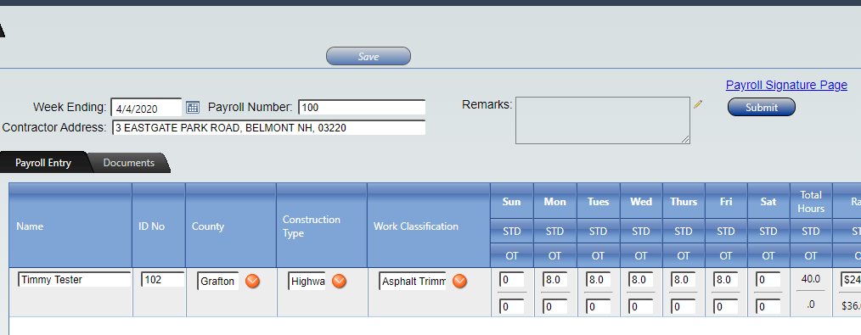
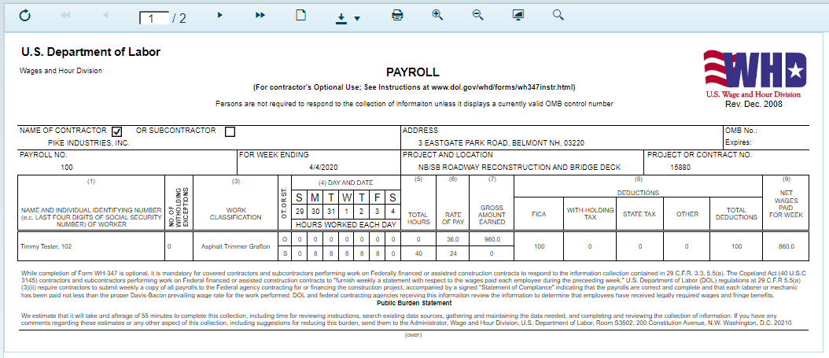
3.4 Sign Certified Payroll
Save Progress
Print pre-populated Payroll Signature Page
Complete needed info
Sign, Scan, Attach Document

Slide 11
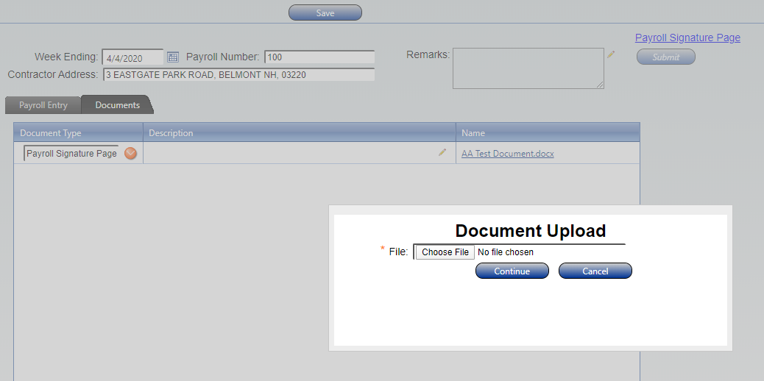
3.5 Attach Documents
Right click >> Add Document
Upload Document
Select Document Type >> Payroll Signature Page
Other Examples:
Fringe Benefit Breakout
Apprentice Certificate

Slide 12
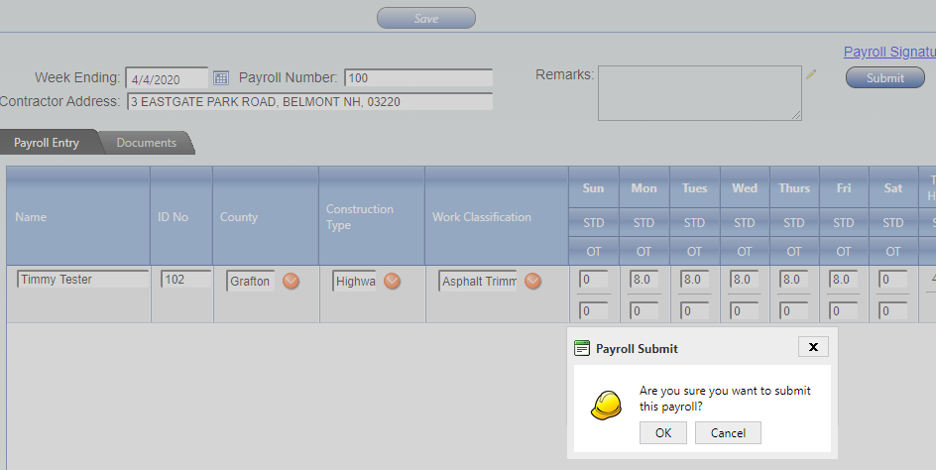
3.6 Submit payroll to Prime
Click Submit
Validations
Confirm Submission

Slide 13
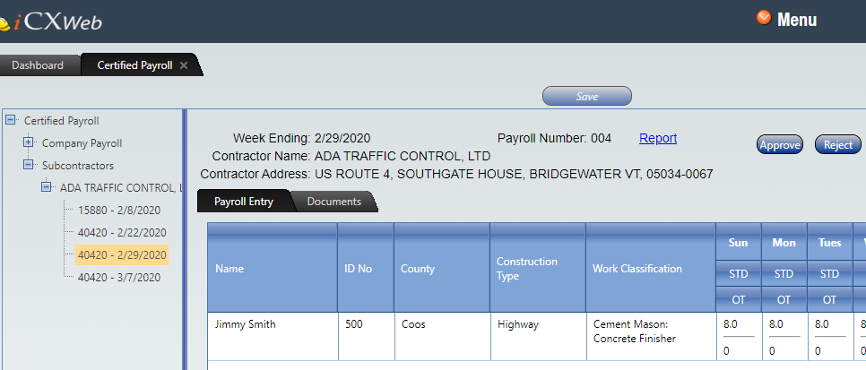
4.0 Subcontractor – Review Submitted Payroll
Subcontractors
Documents
Approve/Reject

Slide 14
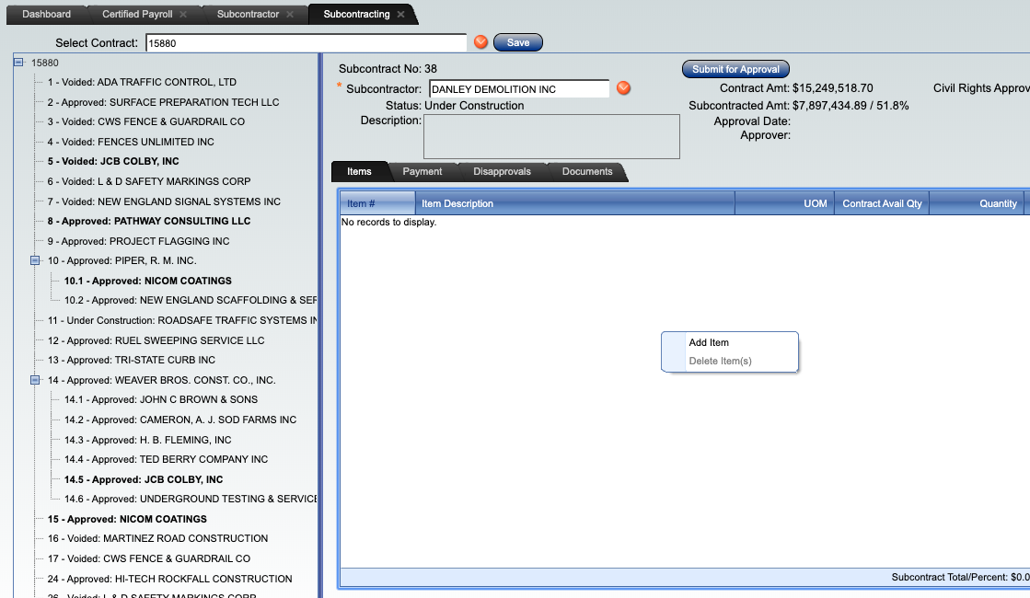
5.0 Subcontracting – Add Subcontractor
Add Sub Contractor
Add Items
Submit for Approval

Slide 15
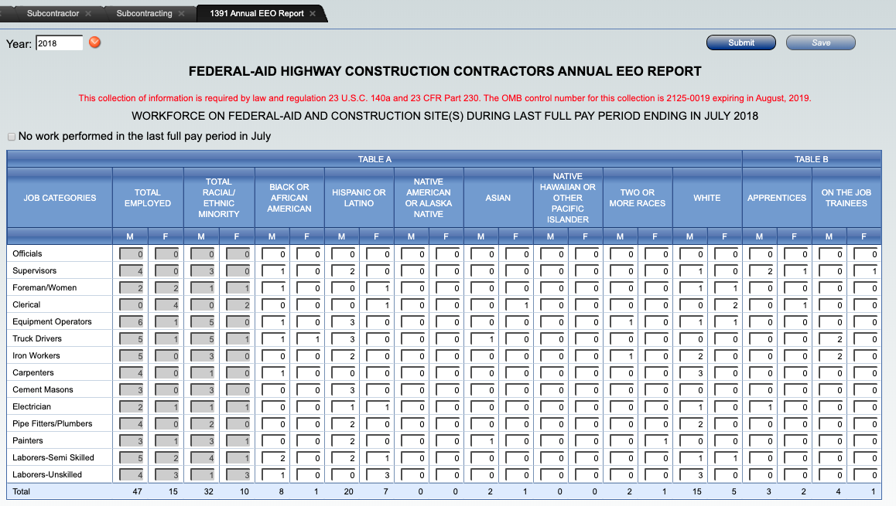
6.0 1391 Annual EEO Report
Same process, just submitting online
Last full paid week in July for work on Federal projects only
Select Contract
Select Year
Complete Data
Submit

Slide 16
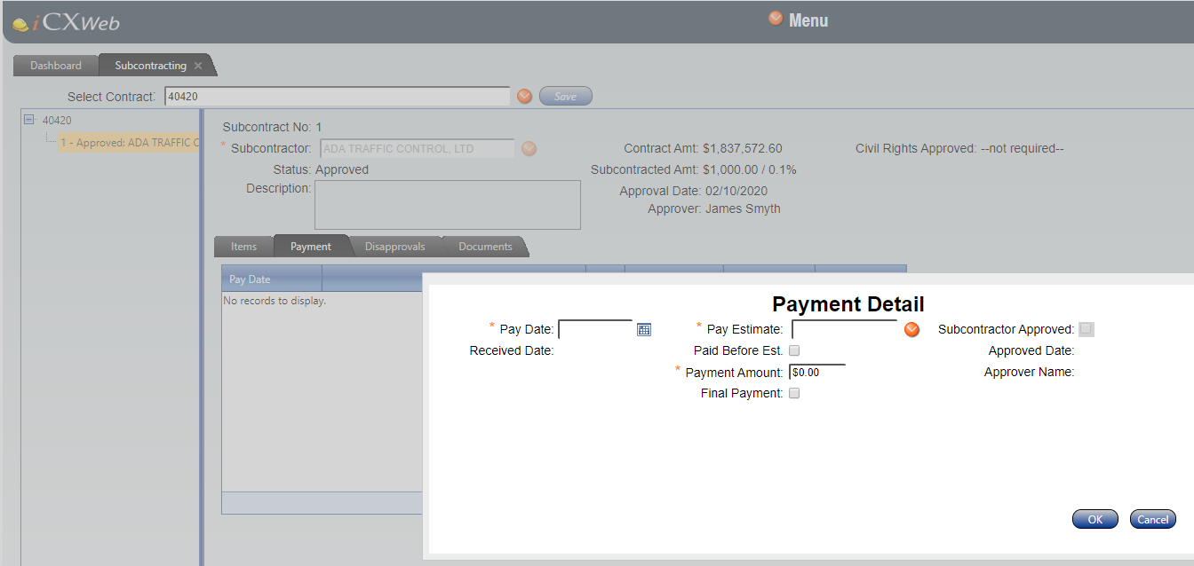
7.0 Prompt Payment
Entry by Prime
Add Payment
Payment Details

Slide 17
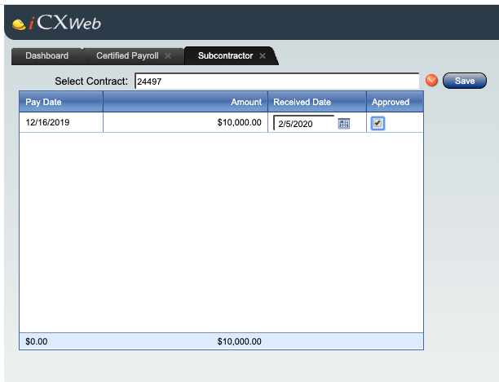
7.1 Sub Contractor Payment Approval
Approved by Subcontractor
Select Contract
Approve

